Slide 1
Neuronal Dynamics: Computational Neuroscience of Single Neurons
Biological Modeling of Neural Networks
1.1 Neurons and Synapses:
Overview
1.2 The Passive Membrane
- Linear circuit
- Dirac delta-function
1.3 Leaky Integrate-and-Fire Model
1.4 Generalized Integrate-and-Fire Model
1.5. Quality of Integrate-and-Fire Models
Week 1 – neurons and mathematics:
a first simple neuron model
Wulfram Gerstner
EPFL, Lausanne, Switzerland

Slide 2
Biological Modeling of Neural Networks
1.1 Neurons and Synapses:
Overview
1.2 The Passive Membrane
- Linear circuit
- Dirac delta-function
1.3 Leaky Integrate-and-Fire Model
1.4 Generalized Integrate-and-Fire
Model
1.5. Quality of Integrate-and-Fire
Models
Notes:
Welcome!

Slide 3
Neuronal Dynamics – 1.1. Neurons and Synapses/Overview
motor
cortex
How do we recognize?
Models of cogntion
Weeks 10-14
frontal
cortex
visual
cortex
to motor
output

Slide 4
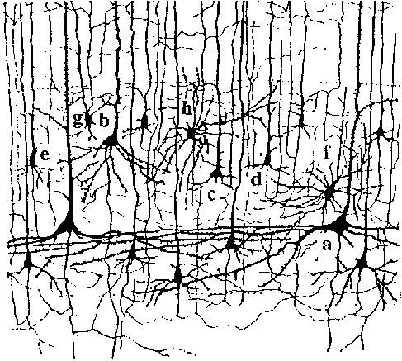
Neuronal Dynamics – 1.1. Neurons and Synapses/Overview
10 000 neurons
3 km wire
motor
cortex
1mm
frontal
cortex
to motor
output

Slide 5
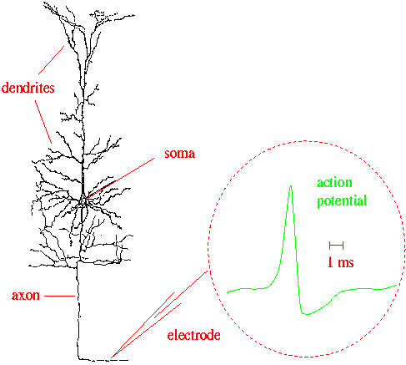
Neuronal Dynamics – 1.1. Neurons and Synapses/Overview
Signal:
action potential (spike)
10 000 neurons
3 km wire
1mm
action
potential
Ramon y Cajal

Slide 6
Neuronal Dynamics – 1.1. Neurons and Synapses/Overview
Hodgkin-Huxley type models:
Biophysics, molecules, ions
(week 2)
Signal:
action potential (spike)
-70mV
Na⁺
action
potential
K⁺
Ca²⁺
Ions/proteins

Slide 7
Neuronal Dynamics – 1.1. Neurons and Synapses/Overview
Signal:
action potential (spike)
action
potential

Slide 8
Neuronal Dynamics – 1.1. Neurons and Synapses/Overview
Integrate-and-fire models:
Formal/phenomenological
(week 1 and week 6+7)
Spike emission
Spike reception
synapse
t
-spikes are events
-triggered at threshold
-spike/reset/refractoriness
Postsynaptic
potential

Slide 9
Noise and variability in integrate-and-fire models
j
Spike emission
i
Output
-spikes are rare events
-triggered at threshold
Subthreshold regime:
trajectory of potential shows fluctuations
Random spike arrival

Slide 10
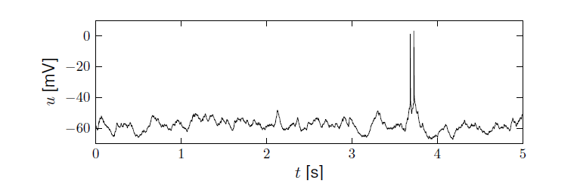
Neuronal Dynamics – membrane potential fluctuations
Spontaneous activity in vivo
electrode
What is noise?
What is the neural code?
(week 8+9)
Brain
awake mouse, cortex, freely whisking,
Crochet et al., 2011

Slide 11
Neuronal Dynamics – Quiz 1.1
A cortical neuron sends out signals which are called:
[ ] action potentials
[ ] spikes
[ ] postsynaptic potential
The dendrite is a part of the neuron
[ ] where synapses are located
[ ] which collects signals from other
neurons
[ ] along which spikes are sent to other
neurons
In an integrate-and-fire model, when the voltage hits the threshold:
[ ] the neuron fires a spike
[ ] the neuron can enter a state of
refractoriness
[ ] the voltage is reset
[ ] the neuron explodes
In vivo, a typical cortical neuron exhibits
[ ] rare output spikes
[ ] regular firing activity
[ ] a fluctuating membrane potential
Multiple answers possible!

Slide 12
Neural Networks and Biological Modeling – 1.1. Overview
Week 1: A first simple neuron model/
neurons and mathematics
Week 2: Hodgkin-Huxley models and
biophysical modeling
Week 3: Two-dimensional models and
phase plane analysis
Week 4: Two-dimensional models
Dendrites
Week 5,6,7: Associative Memory,
Learning, Hebb, Hopfield
Week 8,9: Noise models, noisy neurons
and coding
Week 10: Estimating neuron models for
coding and decoding
Week 11-14: Networks and cognitions
action
potential

Slide 13
Neural Networks and Biological modeling
Course: Monday : 9:15-13:00
have your laptop
with you
A typical Monday:
1st lecture 9:15-9:50
1st exercise 9:50-10:00
2nd lecture 10:15-10:35
2nd exercise 10:35-11:00
3rd lecture 11:15 – 11:40
3rd exercise 12:15-13:00
paper and pencil
paper and pencil
paper and pencil
OR interactive toy
examples on computer
Course of 4 credits = 6 hours of work per week
4 ‘contact’ + 2 homework
http://lcn.epfl.ch/
moodle.eplf.ch

Slide 14
Neural Networks and Biological Modeling
Questions?

Slide 15
Neuronal Dynamics: Computational Neuroscience of Single Neurons
Week 1 – part 2: The Passive Membrane
1.1 Neurons and Synapses:
Overview
1.2 The Passive Membrane
- Linear circuit
- Dirac delta-function
1.3 Leaky Integrate-and-Fire Model
1.4 Generalized Integrate-and-Fire Model
1.5. Quality of Integrate-and-Fire Models
Week 1 – neurons and mathematics:
a first simple neuron model
Wulfram Gerstner
EPFL, Lausanne, Switzerland

Slide 16
Neuronal Dynamics – 1.2. The passive membrane
electrode
Spike emission
synapse
t
potential
Integrate-and-fire model

Slide 17
Neuronal Dynamics – 1.2. The passive membrane
j
i
Spike reception
I
Subthreshold regime
- linear
- passive membrane
- RC circuit

Slide 18
Neuronal Dynamics – 1.2. The passive membrane
I(t)
Time-dependent input
i
I(t)
Math development:
Derive equation
u

Slide 19
Passive Membrane Model
I(t)
u

Slide 20
Passive Membrane Model
j
i
I
Math Development:
Voltage rescaling

Slide 21
Passive Membrane Model

Slide 22
Passive Membrane Model/Linear differential equation
Free solution:
exponential decay

Slide 23
Start Exerc. at 9:47.
Next lecture at
10:15
Neuronal Dynamics – Exercises NOW
Step current input:
Pulse current input:
arbitrary current input:
Calculate the voltage,
for the
3 input currents

Slide 24
Passive Membrane Model – exercise 1 now
i
Step current input:
I(t)
TA’s:
Carlos Stein
Hesam Setareh
Samuel Muscinelli
Alex Seeholzer
impulse reception:
impulse response
function
Linear equation
Start Exerc. at 9:47.
Next lecture at
10:15

Slide 25
Triangle: neuron – electricity - math
i
I(t)
u

Slide 26
Pulse input – charge – delta-function
Pulse current input

Slide 27
Dirac delta-function

Slide 28
Neuronal Dynamics – Solution of Ex. 1 – arbitrary input
Arbitrary input
Single pulse
you need to know the solutions
of linear differential equations!

Slide 29
Passive membrane, linear differential equation

Slide 30
Passive membrane, linear differential equation
If you have difficulties,
watch lecture 1.2detour.
Three prerequisits:
Analysis 1-3
Probability/Statistics
Differential Equations or Physics 1-3 or Electrical Circuits

Slide 31
Neuronal Dynamics: Computational Neuroscience of Single Neurons
Week 1 – part 3: Leaky Integrate-and-Fire Model
1.1 Neurons and Synapses:
Overview
1.2 The Passive Membrane
- Linear circuit
- Dirac delta-function
- Detour: solution of 1-dim linear
differential equation
1.3 Leaky Integrate-and-Fire Model
1.4 Generalized Integrate-and-Fire
Model
1.5. Quality of Integrate-and-Fire
Models
Week 1 – neurons and mathematics:
a first simple neuron model
Wulfram Gerstner
EPFL, Lausanne, Switzerland

Slide 32
Neuronal Dynamics – 1.3 Leaky Integrate-and-Fire Model
Notes:
Welcome back: in the previous part we have discussed the passive membrane. A model of passive membrane, is a reasonable description of some of the subthreshold phenomema observed in real neurons, but it cannot account for output spikes. In order to generate spikes, we need to introduce the notion of a threhold.

Slide 33
Neuronal Dynamics – Integrate-and-Fire type Models
Spike emission
Input spike causes an EPSP
= excitatory postsynaptic potential
Simple
Integate-and-Fire Model:
passive membrane
+ threshold
-output spikes are events
-generated at threshold
-after spike: reset/refractoriness
Leaky Integrate-and-Fire Model
Notes:
The simplest integrate-and-fire model is a passive membrane combined with a threshold.

Slide 34
Neuronal Dynamics – 1.3 Leaky Integrate-and-Fire Model
Spike emission
j
i
reset
I
linear
Fire+reset
threshold

Slide 35
Neuronal Dynamics – 1.3 Leaky Integrate-and-Fire Model
I(t)
Time-dependent input
i
Math development:
Response to step current
I(t)
-spikes are events
-triggered at threshold
-spike/reset/refractoriness

Slide 36
Neuronal Dynamics – 1.3 Leaky Integrate-and-Fire Model
I(t)
CONSTANT input/step input
i
I(t)
I(t)

Slide 37
Leaky Integrate-and-Fire Model (LIF)
LIF
If
‘Firing’
Repetitive, current I0
u
T
1/T
frequency-current
relation
t
Repetitive, current I1> I0
u
f-I curve
t
I

Slide 38
Neuronal Dynamics – First week, Exercise 2
frequency-current
relation
1/T
f-I curve
I

Slide 39
EXERCISE 2 NOW: Leaky Integrate-and-fire Model (LIF)
LIF
If firing:
Exercise!
Calculate the
interspike interval T
for constant input I.
Firing rate is f=1/T.
Write f as a function of I.
What is the
frequency-current curve
f=g(I) of the LIF?
repetitive
u
t
Start Exerc. at 10:55.
Next lecture at
11:15

Slide 40
Neuronal Dynamics: Computational Neuroscience of Single Neurons
Week 1 – part 4: Generalized Integrate-and-Fire Model
1.1 Neurons and Synapses:
Overview
1.2 The Passive Membrane
- Linear circuit
- Dirac delta-function
1.3 Leaky Integrate-and-Fire Model
1.4 Generalized Integrate-and-Fire
Model
1.5. Quality of Integrate-and-Fire
Models
Week 1 – neurons and mathematics:
a first simple neuron model
Wulfram Gerstner
EPFL, Lausanne, Switzerland

Slide 41
Neuronal Dynamics – 1.4. Generalized Integrate-and Fire
Spike emission
reset
Integrate-and-fire model
LIF: linear + threshold
Notes:
In the previous lecture, we have see the leaky integrate-and-fire model: The responses to incoming spikes are summed LINEARLY, until a threshold is reached.
Let us now look again at the leaky IF, but from a slighlty different perspective

Slide 42
Neuronal Dynamics – 1.4. Leaky Integrate-and Fire revisited
I=0
I>0
LIF
If firing:
u
resting
repetitive
u
u
t
t
Notes:
The LIF is characterized by a linear differential equation.

Slide 43
Neuronal Dynamics – 1.4. Nonlinear Integrate-and Fire
LIF
NLIF
If firing:

Slide 44
Neuronal Dynamics – 1.4. Nonlinear Integrate-and Fire
Nonlinear
Integrate-and-Fire
I=0
I>0
NLIF
u
u
firing:

Slide 45
Nonlinear Integrate-and-fire Model
Spike emission
j
i
F
reset
I
NONlinear
Fire+reset
threshold

Slide 46
Nonlinear Integrate-and-fire Model
I=0
I>0
u
u
Quadratic I&F:
NONlinear
Fire+reset
threshold

Slide 47
Nonlinear Integrate-and-fire Model
I=0
I>0
u
u
Quadratic I&F:
exponential I&F:
Fire+reset

Slide 48
Nonlinear Integrate-and-fire Model
I=0
u
exponential I&F:
NONlinear
Fire+reset
threshold

Slide 49
Nonlinear Integrate-and-fire Model
Where is the firing threshold?
I=0
I>0
u
u
resting
u
t
t

Slide 50
Neuronal Dynamics: Computational Neuroscience of Single Neurons
Week 1 – part 5: How good are Integrate-and-Fire Model?
1.1 Neurons and Synapses:
Overview
1.2 The Passive Membrane
- Linear circuit
- Dirac delta-function
1.3 Leaky Integrate-and-Fire Model
1.4 Generalized Integrate-and-Fire
Model
- where is the firing threshold?
1.5. Quality of Integrate-and-Fire
Models
- Neuron models and experiments
Week 1 – neurons and mathematics:
a first simple neuron model
Wulfram Gerstner
EPFL, Lausanne, Switzerland

Slide 51
Neuronal Dynamics – 1.5.How good are integrate-and-fire models?
Can we compare neuron models
with experimental data?

Slide 52
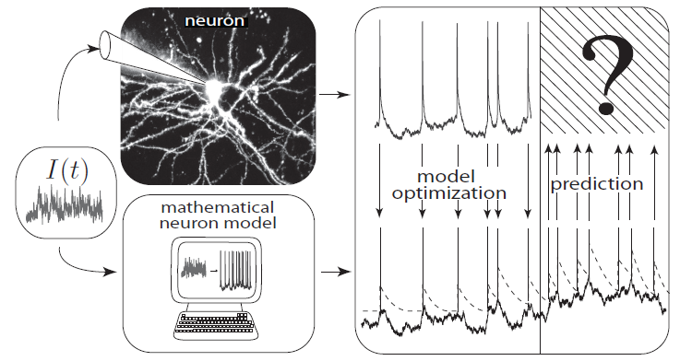
Neuronal Dynamics – 1.5.How good are integrate-and-fire models?
What is a good neuron model?
Can we compare neuron models
with experimental data?
Notes:
What is a good neuron model? Would the nonlinear integrate-and-fire model be good?

Slide 53
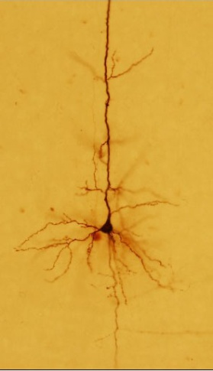
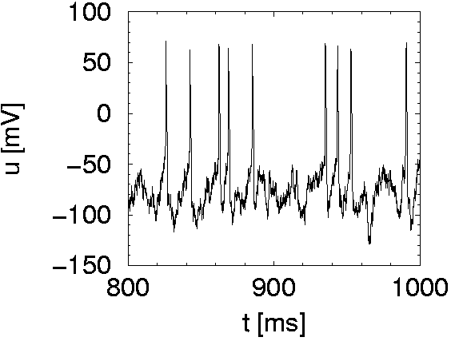
Neuronal Dynamics – 1.5.How good are integrate-and-fire models?
I(t)
Spike
Integrate-and-fire model

Slide 54
Nonlinear Integrate-and-fire Model
I=0
Can we measure
the function F(u)?
u
Quadratic I&F:
exponential I&F:
Fire+reset

Slide 55
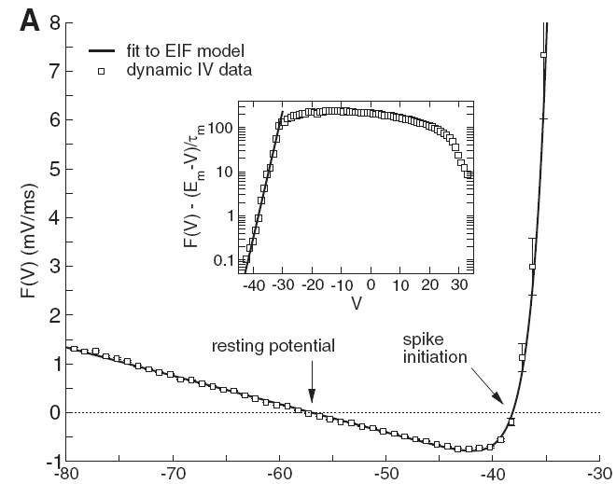
Neuronal Dynamics – 1.5.How good are integrate-and-fire models?
voltage
I(t)
u [mV]
Badel et al., J. Neurophysiology 2008
Notes:
What is a good neuron model? Would the nonlinear integrate-and-fire model be good?

Slide 56
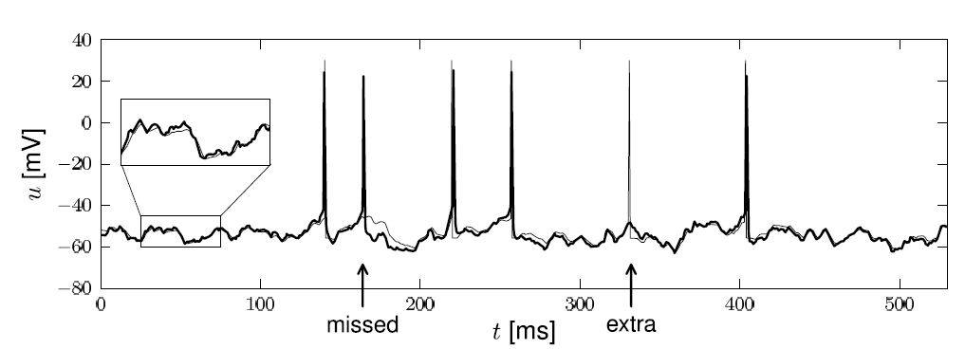
Neuronal Dynamics – 1.5.How good are integrate-and-fire models?
Notes:
What is a good neuron model? Would the nonlinear integrate-and-fire model be good?

Slide 57
Neuronal Dynamics – 1.5.How good are integrate-and-fire models?
Nonlinear integrate-and-fire models
are good
Mathematical description → prediction
Need to add
- adaptation
- noise
- dendrites/synapses
Computer ecercises:
Python
Notes:
What is a good neuron model? Would the nonlinear integrate-and-fire model be good?

Slide 58
Neural Networks and Biological - Exercise 3
I=0
Homework!
u

Slide 59
Neuronal Dynamics – References and Suggested Reading
Reading: W. Gerstner, W.M. Kistler, R. Naud and L. Paninski,
Neuronal Dynamics: from single neurons to networks and
models of cognition. Chapter 1: Introduction. Cambridge Univ. Press, 2014
Selected references to linear and nonlinear integrate-and-fire models
- Lapicque, L. (1907). Recherches quantitatives sur l'excitation electrique des nerfs traitee comme une polarization. J. Physiol. Pathol. Gen., 9:620-635.
Stein, R. B. (1965). A theoretical analysis of neuronal variability. Biophys. J., 5:173-194.
-Ermentrout, G. B. (1996). Type I membranes, phase resetting curves, and synchrony.
Neural Computation, 8(5):979-1001.
Fourcaud-Trocme, N., Hansel, D., van Vreeswijk, C., and Brunel, N. (2003). How spike generation mechanisms determine the neuronal response to fluctuating input.
J. Neuroscience, 23:11628-11640.
Badel, L., Lefort, S., Berger, T., Petersen, C., Gerstner, W., and Richardson, M. (2008). Biological Cybernetics, 99(4-5):361-370.
- Latham, P. E., Richmond, B., Nelson, P., and Nirenberg, S. (2000). Intrinsic dynamics in neuronal networks. I. Theory. J. Neurophysiology, 83:808-827.

Slide 60
Neuronal Dynamics –
THE END
MATH DETOUR SLIDES

Slide 61
Neuronal Dynamics: Computational Neuroscience of Single Neurons
Week 1 – part 2: Detour/Linear differential equation
1.1 Neurons and Synapses:
Overview
1.2 The Passive Membrane
- Linear circuit
- Dirac delta-function
- Detour: solution of 1-dim linear
differential equation
1.3 Leaky Integrate-and-Fire Model
1.4 Generalized Integrate-and-Fire
Model
1.5. Quality of Integrate-and-Fire
Models
Week 1 – neurons and mathematics:
a first simple neuron model
Wulfram Gerstner
EPFL, Lausanne, Switzerland

Slide 62
Neuronal Dynamics – 1.2Detour – Linear Differential Eq.

Slide 63
Neuronal Dynamics – 1.2Detour – Linear Differential Eq.
Math development:
Response to step current
I(t)
u

Slide 64
Neuronal Dynamics – 1.2Detour – Step current input
I(t)
u

Slide 65
Neuronal Dynamics – 1.2Detour – Short pulse input
short pulse:
Math development:
Response to short
current pulse
I(t)
u

Slide 66
Neuronal Dynamics – 1.2Detour – Short pulse input
short pulse:
I(t)
u

Slide 67
Neuronal Dynamics – 1.2Detour – arbitrary input
Single pulse
Multiple pulses:
Impulse response function,
Green’s function

Slide 68
Neuronal Dynamics – 1.2Detour – Greens function
Single pulse
Multiple pulses:
Impulse response function,
Green’s function

Slide 69
Neuronal Dynamics – 1.2Detour – arbitrary input
Arbitrary input
Single pulse
you need to know the solutions
of linear differential equations!

Slide 70
Neuronal Dynamics – Exercises 1.2/Quiz 1.2
If you don’t feel at ease yet,
spend 10 minutes on these
mathematical exercises

