Slide 1
Biological Modeling of Neural Networks:
Week 9 – adaptation and firing patterns
9.1 Firing patterns and adaptation
9.2 AdEx model
- Firing patterns and adaptation
9.3 Spike Response Model (SRM)
- Integral formulation
Week 9 – Adaptation and firing patterns
Wulfram Gerstner
EPFL, Lausanne, Switzerland

Slide 2
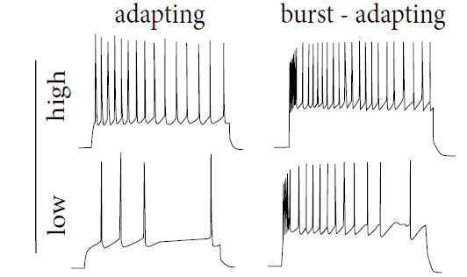
Neuronal Dynamics – 9.1 Adaptation
Step current input – neurons show adaptation
I(t)
Data:
Markram et al.
(2004)
1-dimensional (nonlinear) integrate-and-fire model cannot do this!

Slide 3
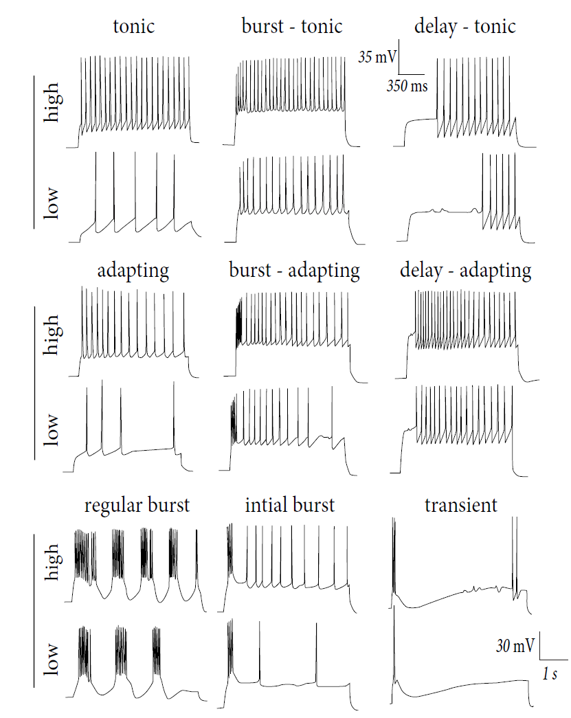
Firing patterns:
Response to
Step currents,
Exper. Data,
Markram et al.
(2004)
I(t)

Slide 4
Biological Modeling of Neural Networks:
Week 9 – adaptation and firing patterns
9.1 Firing patterns and adaptation
9.2 AdEx model
- Firing patterns and adaptation
9.3 Spike Response Model (SRM)
- Integral formulation
Week 9 – Adaptation and firing patterns
Wulfram Gerstner
EPFL, Lausanne, Switzerland

Slide 5
Neuronal Dynamics – 9.2 Adaptive Exponential I&F
Add adaptation variables:
Blackboard !
Exponential I&F
+ 1 adaptation var.
= AdEx
SPIKE AND RESET
after each spike
AdEx model,
Brette&Gerstner (2005):
jumps by an amount

Slide 6
Firing patterns:
Response to
Step currents,
Exper. Data,
Markram et al.
(2004)
I(t)

Slide 7
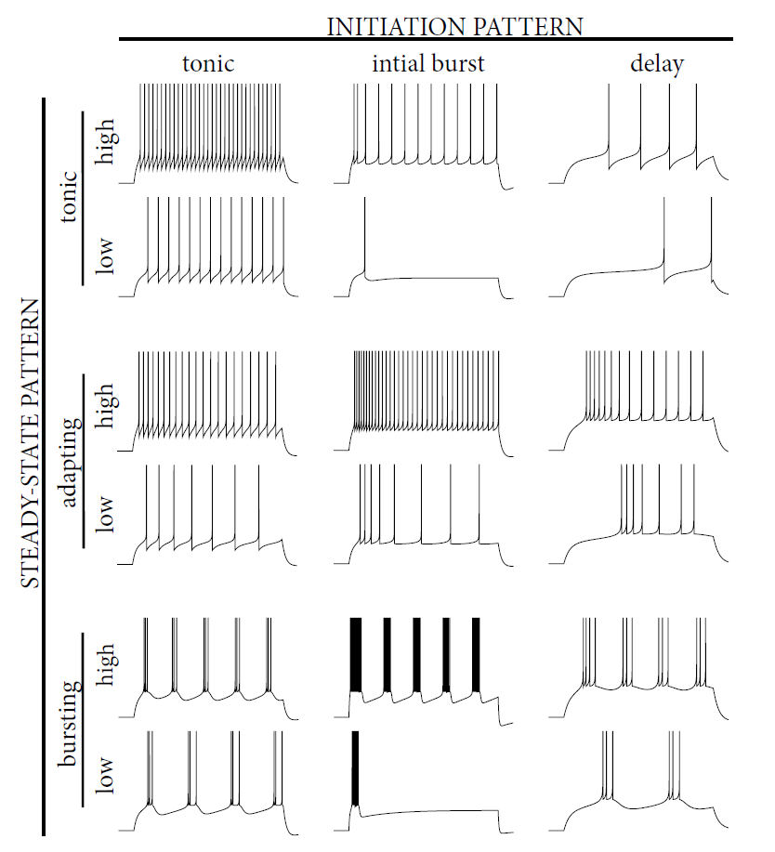
Firing patterns:
Response to
Step currents,
AdEx Model,
Naud&Gerstner
I(t)
Image:
Neuronal Dynamics,
Gerstner et al.
Cambridge (2002)

Slide 8
Neuronal Dynamics – 9.2 Adaptive Exponential I&F
AdEx model
Phase plane analysis!
Can we understand the different firing patterns?

Slide 9
Neuronal Dynamics – Quiz 9.1. Nullclines of AdEx
A - What is the qualitative
shape of the w-nullcline?
[ ] constant
[ ] linear, slope a
[ ] linear, slope 1
[ ] linear + quadratic
[ ] linear + exponential
B - What is the qualitative
shape of the u-nullcline?
[ ] linear, slope 1
[ ] linear, slope 1/R
[ ] linear + quadratic
[ ] linear w. slope 1/R+ exponential
1 minute
Restart at 9:38

Slide 10
Biological Modeling of Neural Networks:
Week 9 – part 2b : Firing Patterns
9.1 What is a good neuron model?
- Models and data
9.2 AdEx model
- Firing patterns and adaptation
9.3 Spike Response Model (SRM)
- Integral formulation
9.4 Generalized Linear Model
- Adding noise to the SRM
9.5 Parameter Estimation
- Quadratic and convex optimization
9.6. Modeling in vitro data
- how long lasts the effect of a spike?
Week 9 – Optimizing Neuron Models
For Coding and Decoding
Wulfram Gerstner
EPFL, Lausanne, Switzerland

Slide 11
after each spike
AdEx model
u is reset to ur
after each spike
w jumps by an amount b
parameter a – slope of w-nullcline
Can we understand the different firing patterns?

Slide 12
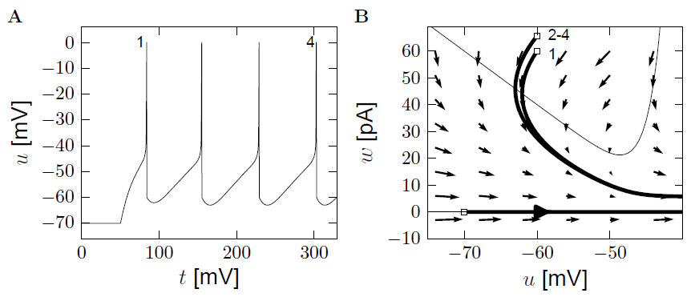
AdEx model – phase plane analysis: large b
a=0
u-nullcline
b
u is reset to ur

Slide 13
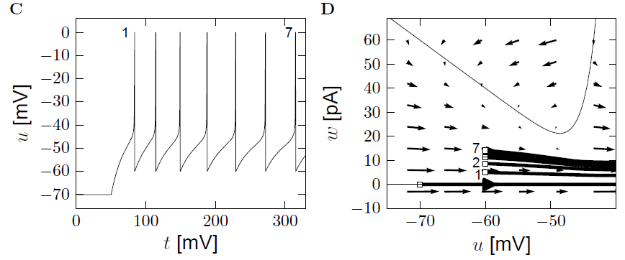
AdEx model – phase plane analysis: small b
adaptation
u-nullcline
b
u is reset to ur

Slide 14
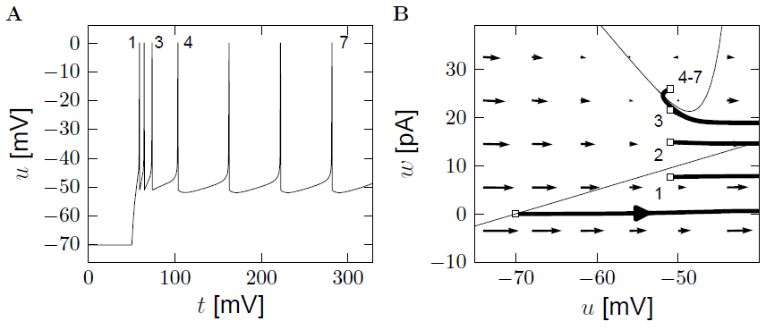
Quiz 9.2: AdEx model – phase plane analysis
What firing pattern do you expect?
(i) Adapting
(ii) Bursting
(iii) Initial burst
(iv)Non-adapting
u-nullcline
b
u is reset to ur

Slide 15
AdEx model – phase plane analysis: a>0
u-nullcline
b
u is reset to ur

Slide 16
Neuronal Dynamics – 9.2 AdEx model and firing patterns
after each spike
u is reset to ur
after each spike
w jumps by an amount b
parameter a – slope of w nullcline
Firing patterns arise from different parameters!
See Naud et al. (2008), see also Izikhevich (2003)

Slide 17
Neuronal Dynamics – Review: Nonlinear Integrate-and-fire
(1)
(2)
Best choice of f : linear + exponential
BUT: Limitations – need to add
Adaptation on slower time scales
Possibility for a diversity of firing patterns
Increased threshold after each spike
Noise

Slide 18
Neuronal Dynamics – 9.2 AdEx with dynamic threshold
Add dynamic threshold:
Threshold increases after each spike

Slide 19
Neuronal Dynamics – 9.2 Generalized Integrate-and-fire
add
Adaptation variables
Possibility for firing patterns
Dynamic threshold
Noise

Slide 20
Biological Modeling of Neural Networks:
Week 9 – part 3: Spike Response Model (SRM)
9.1 What is a good neuron model?
- Models and data
9.2 AdEx model
- Firing patterns and adaptation
9.3 Spike Response Model (SRM)
- Integral formulation
9.4 Generalized Linear Model
- Adding noise to the SRM
9.5 Parameter Estimation
- Quadratic and convex optimization
9.6. Modeling in vitro data
- how long lasts the effect of a spike?
Week 9 – Optimizing Neuron Models
For Coding and Decoding
Wulfram Gerstner
EPFL, Lausanne, Switzerland

Slide 21
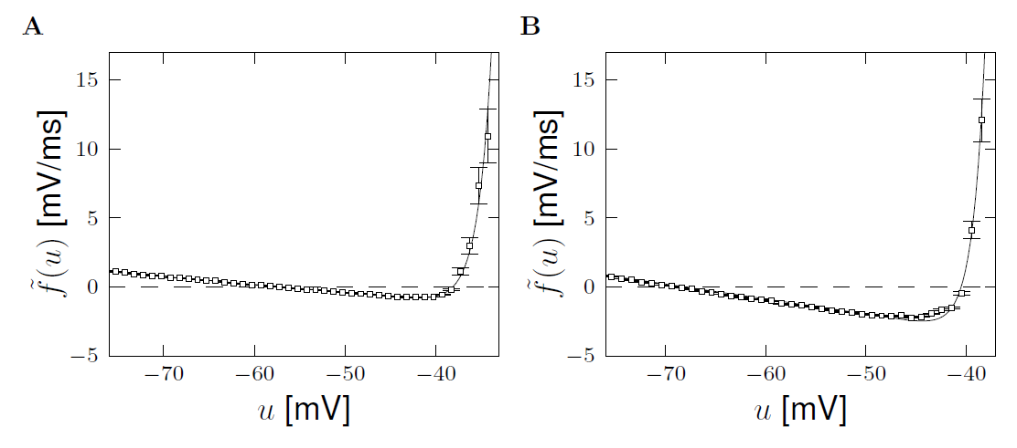
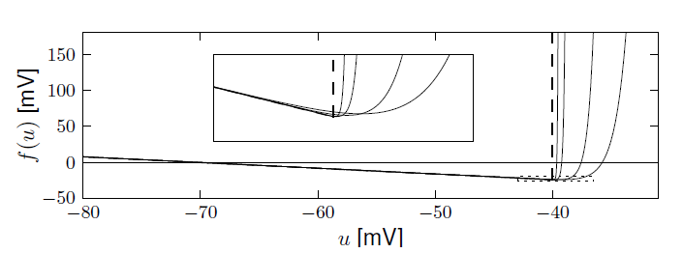
Exponential versus Leaky Integrate-and-Fire
Badel et al (2008)
Leaky Integrate-and-Fire:
Replace nonlinear kink by threshold
Reset if u=

Slide 22
Neuronal Dynamics – 9.3 Adaptive leaky integrate-and-fire
after each spike
SPIKE AND RESET
jumps by an amount
Dynamic threshold

Slide 23
Neuronal Dynamics – 9.3 Adaptive leaky I&F and SRM
Adaptive
leaky I&F
Linear equation → can be integrated!
Spike Response Model (SRM)
Gerstner et al. (1996)

Slide 24
Neuronal Dynamics – 9.3 Spike Response Model (SRM)
Gerstner et al.,
1993, 1996
i
Input
I(t)
Spike emission
u(t)
Arbitrary
Linear filters
potential
threshold

Slide 25
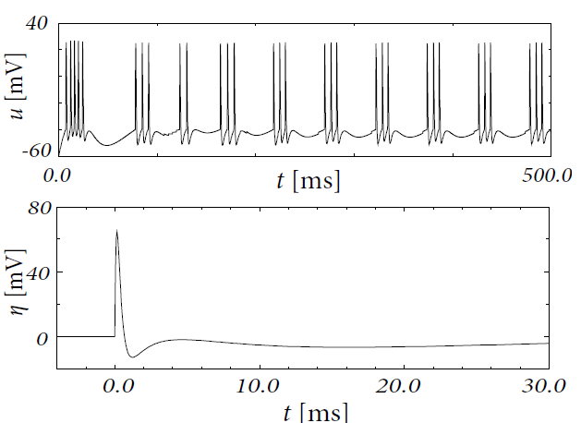
Neuronal Dynamics – 9.3 Bursting in the SRM
SRM with appropriate
leads to bursting

Slide 26
Exercise 1: from adaptive IF to SRM
Next lecture
at 9:57/10:15
Integrate the above system of two differential equations so as to rewrite the equations as
potential
A – what is ?
(i)
(ii)
B – what is ?
(iii)
(iv) Combi of
(i) + (iii)
Notes:
Exercise should start before the break.

Slide 27
Neuronal Dynamics – 9.3 Spike Response Model (SRM)
Gerstner et al.,
1993, 1996
Input
I(t)
S(t)
+
potential
threshold
firing if

Slide 28
Neuronal Dynamics – 9.3 Spike Response Model (SRM)
potential
+
threshold
Linear filters for
- input
- threshold
- refractoriness

